Slide 1






VISVESVARAYA TECHNOLOGICAL UNIVERSITY
“Jnana Sangama” Belgaum-590018
RAJARAJESHWARI COLLEGE OF ENGINEERING
#14 Ramohalli Cross, Kumbalagodu, Mysore Road, Bangalore-560074
Affiliated To VTU, Belgaum, Approved By AICTE, New Delhi
DEPARTMENT OF ELECTRICAL AND ELECTRONICS ENGINEERING (NBA & NAAC ‘A’ Accredited )
Project Presentation On
“IOT BASED INDUSTRIAL AUTOMATION PROTECTION AND MONITORING SYSTEM USING ARDUINO”
Batch Members:
MANJUNATH J S 1RR14EE411
RITU PANJA 1RR14EE053
SALMAN KHAN 1RR14EE035
SHASHIKALA 1RR15EE418
Under the Guidance of :
Prof. Shivalingaiah K L
Assoc.Professor, Dept of EEE, RRCE

Slide 2
CONTENTS:
INTRODUCTION
ABSTRACT
LITERATURE SURVEY
BLOCK DIAGRAM
IMPLEMENTATION
APPLICATIONS
ADVANTAGES AND DISADVANTAGES
RESULTS
CONCLUSION
REFERENCES

Slide 3
INTRODUCTION
WHAT IS INDUSTRIAL AUTOMATION?
It is the use of control systems, such as computers or robots, and information technologies for handling different processes and machineries in an industry to replace a human being.
WHAT IS ARDUNIO UNO?
The Arduino UNO is an open-source microcontroller board based on the Microchip ATmega328P microcontroller. The board is equipped with sets of digital and analog input/output pins that may be interfaced to various expansion boards and other circuits.
WHAT IS IOT?
It is a system of interrelated computing devices, mechanical and digital machines, objects, animals or people that are provided with unique identifiers (UIDs) and the ability to transfer data over a network without requiring human-to-human or human-to-computer interaction.

Slide 4
ABSTRACT
Automation is one of the increasing need with in industries applications. Automation reduces the human efforts by replacing the system which are self operated.
We are developing a system which will automatically monitor the industrial applications and generate Alerts/Alarms or take intelligent decisions using concept of IoT.
Safety from leaking of raw gas and fire are the most important requirements of industries security system for people.
This system also helps us take some crucial decision from any point of the world within internet network
Wifi shield is being used to act as service point between network and connecting network.

Slide 5
LITERATURE SURVEY
“Industrial Automation using IoT” International Research Journal of Engineering and Technology (IRJET).Volume: 04 Issue: 06 | June-2017
To build the system which can monitor the sensor data and upload it over internet and also capable of taking some crucial decision within industries using the IoT.
“IoT Based Industrial Parameters Monitoring and Alarming System using Arduino” International Journal of Engineering Science and Computing, April 2018
systems is usually associated with one single concept, the Internet of Things (IoT), where through the use of sensors, the entire physical infrastructure is closely coupled with information and communication technologies; where intelligent monitoring and management can be achieved via the usage of networked embedded devices.

Slide 6
CONTINUED….
“Complete Industrial Solution for Automation in Temperature and Humidity Monitoring using LabVIEW”
The system provides for remote monitoring of the temperature and humidity levels of different parts of the plant with the help of the sensors and is based on labView software platform.

Slide 7
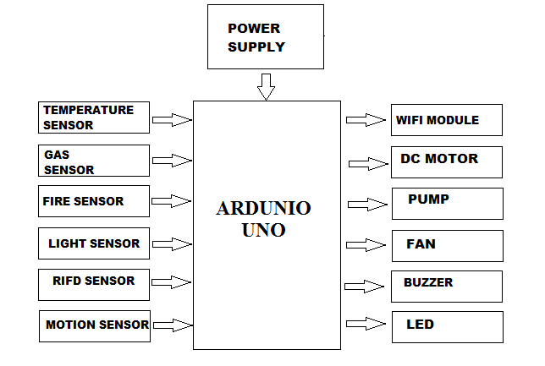
BLOCK DIAGRAM

Slide 8
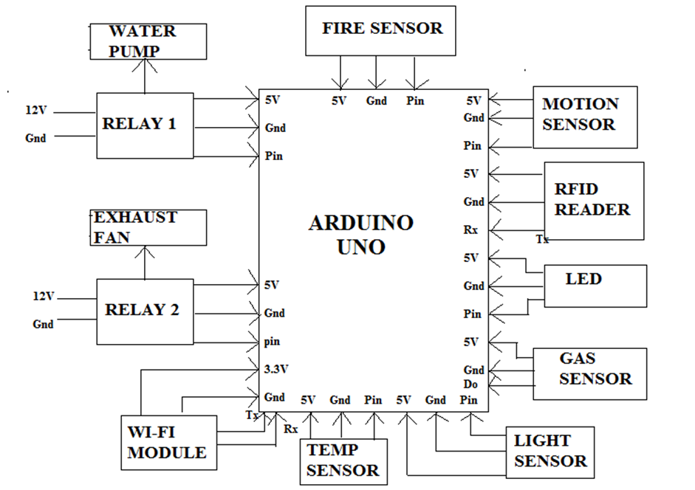
WIRING DIAGRAM

Slide 9
HARDWARE IMPLEMENTATION
Arduino Uno
Wi-Fi Module
Light Sensor
Gas Sensor
Temperature Sensor
Fire Sensor
Motion Sensor
RIFD Sensor
DC Motor
Buzzer
Fan
Pump
Led

Slide 10
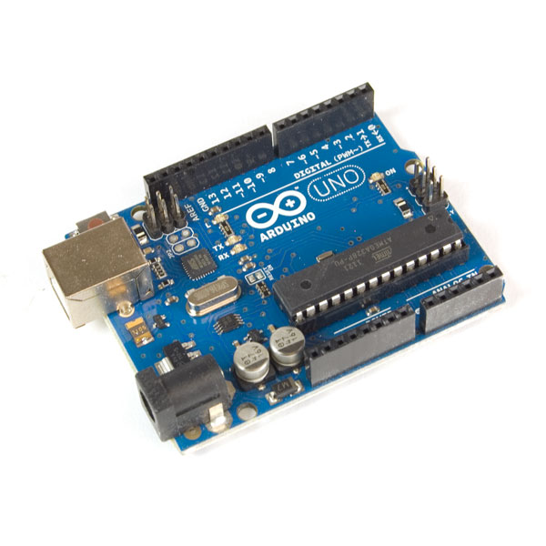
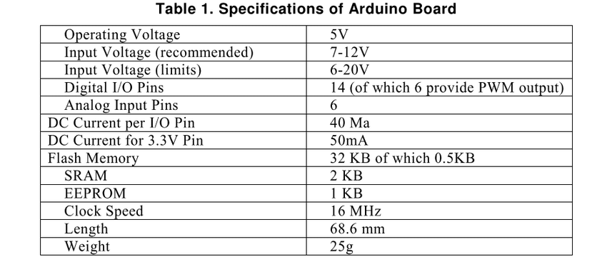
Arduino Uno

Slide 11
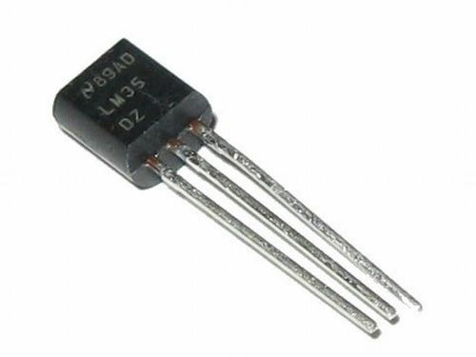
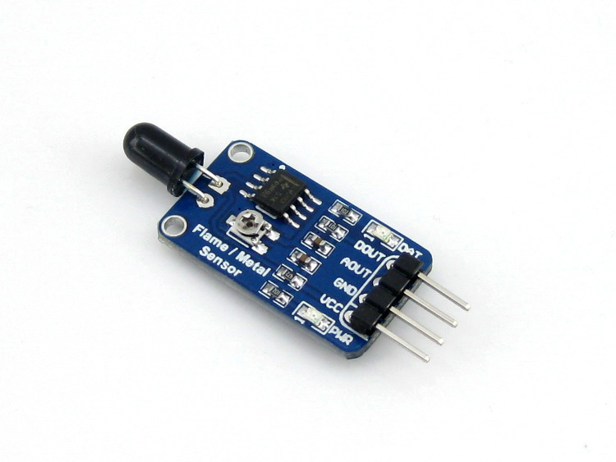
Temperature sensor
Calibrated Directly in Celsius (Centigrade)
0.5°C Ensured Accuracy (at 25°C)
Rated for Full −55°C to 150°C Range
Suitable for Remote Applications
Low-Cost
Operates From 4 V to 30 V
Less Than 60-µA
Fire sensor
LM393 comparator chip
Detection Range: 760 nm to 1100 nm
Operating Voltage: 3.3 V to 5 V
Maximum Output Current: 15 mA
Digital Outputs: 0 and 1
Detection Angle: about 60 degrees
Adjustable sensitivity
LED lights indicators: power (red) and digital switching output (green)
Fixed bolt holes for easy installation
PCB Size: 32 x 14 mm

Slide 12
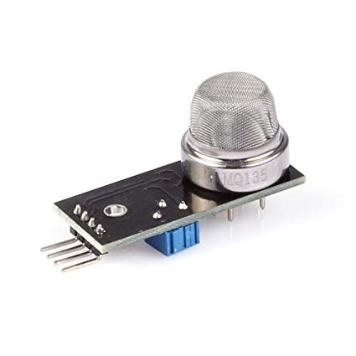
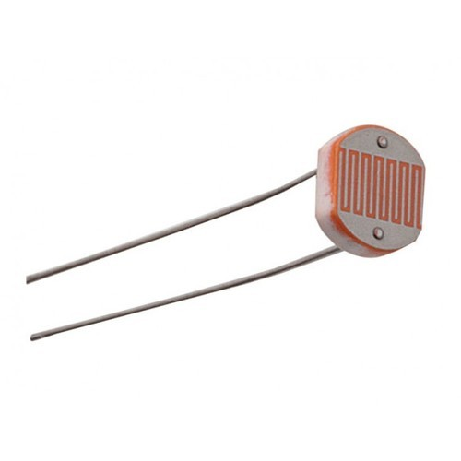
Gas Sensor
Power: 2.5V ~ 5.0V
Good sensitivity to harmful gases in wide range.
It has long life and low cost.
Possesses high sensitivity to ammonia, benzene, sulfide gases.
It is a simple drive circuit
Light sensor
Max power dissipation | 200mW
Max voltage @ 0 lux | 200V
Peak wavelength | 600nm
Min. resistance @ 10lux | 1.8kΩ
Max. resistance @ 10lux | 4.5kΩ
Typ. resistance @ 100lux | 0.7kΩ
Dark resistance after 1 sec | 0.03MΩ
Dark resistance after 5 sec | 0.25MΩ

Slide 13
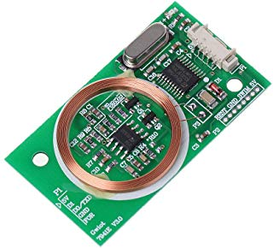
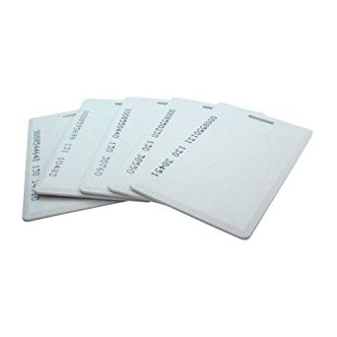
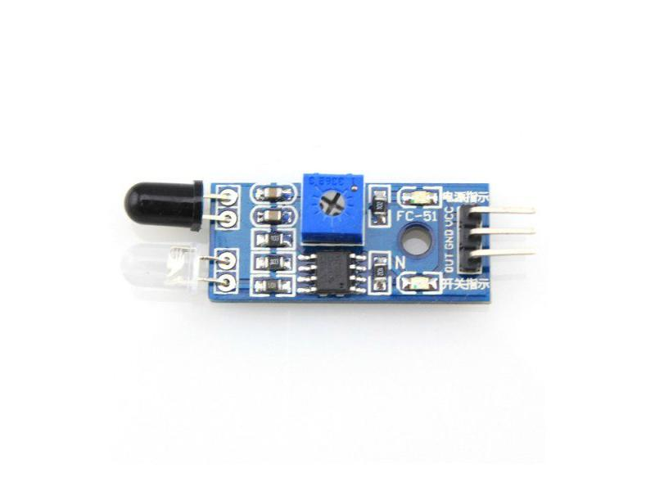
RIFD Sensor
Radio-frequency identification (RFID) uses electromagnetic fields to automatically identify and track tags attached to objects. The tags contain electronically stored information. Passive tags collect energy from a nearby RFID reader's interrogating radio waves.
Motion Sensor
Range | 0.5cm 5 cm
Color | blue
Distance Measuring Range | up to30cm adjustable with pot
Detecting Angle | 35 deg
Weight G | Approx. 10g
Operating Temperature | 0C to 60C 10
Type | IR Obstacle sensor
Voltage | 5v

Slide 14
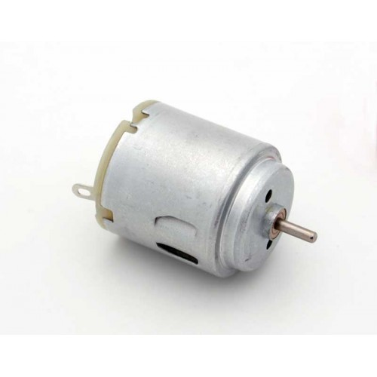
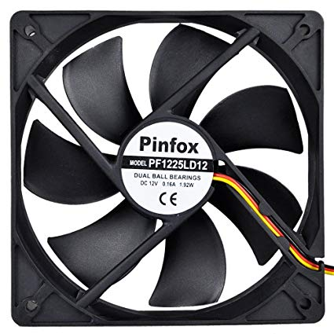
DC Motor
12V – 200RPM
3.6KG DC gearhead motor
2mm rear encoder shaft
Good compromise between speed and torque for small robotic designs.
Fan
Max air flow | 49.7CFM
Maxiam noise | 44dBA
Operation Temperature | -10~75 degree C
Rated speed | 4000 - 5000RPM
Rated voltage | 12 V
Relative humidity | 65%+/-20%

Slide 15
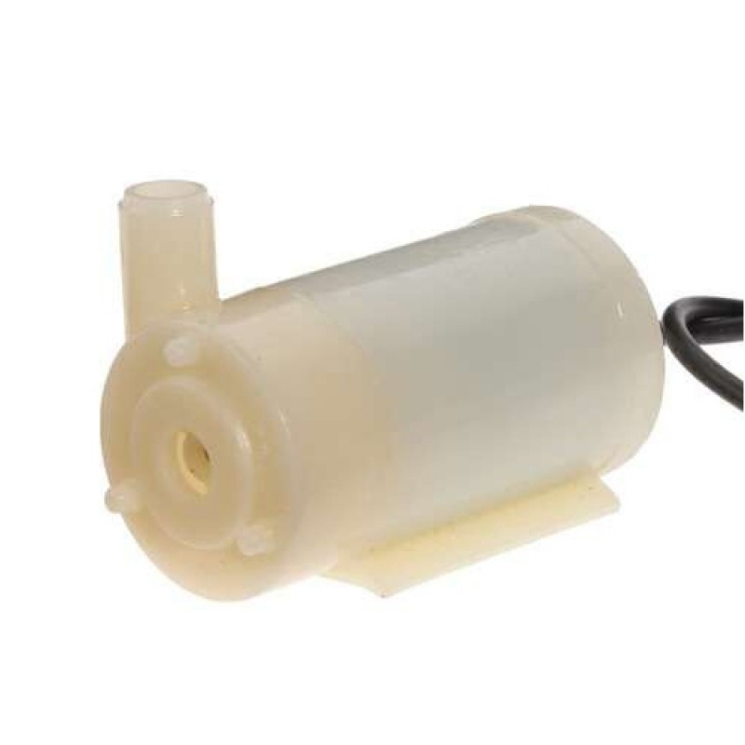
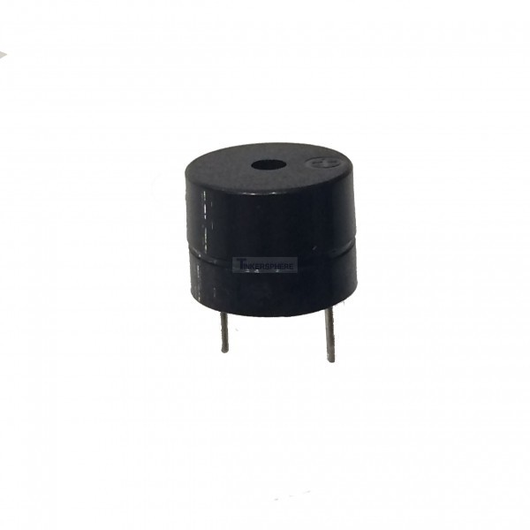
Water Pump
DC Voltage: 3-5V.
Low Noise.
Maximum Lift: 40-110cm / 15.75″-43.4″
Flow rate:80-120L/H.
Outside diameter of water outlet: 7.5mm / 0.3″
Inside diameter of water outlet: 4.7mm / 0.18″
Diameter: Approx. 24mm / 0.95″Length:Approx. 45mm / 1.8″
Height: Approx. 33mm / 1.30″
Buzzer
Voltage : 2 - 5VDC
Maximum current : 30mA/5VDC
Decibel : > 85db/10cm
Resonant frequency : 2500Hz (+/- 300 HZ)
Operating Temperature : -20 to 70 C

Slide 16
FIRE SENSOR
A flame detector is a sensor designed to detect and respond to the presence of a flame or fire, allowing flame detection
Responses to a detected flame depend on the installation, but can include sounding an alarm.

Slide 17
GAS SENSOR:
A GAS sensor or a GAS Detector is a type of chemical sensor which detects/measures the concentration of gas in its vicinity.
Gas sensor interacts with a gas to measure in concentration.
Gas Sensor are extensively used in industry because of their low cost, flexibility in production; simplicity of their use; large number of detectable gases/possible application fields.

Slide 18
TEMPERATURE SENSOR:
Temperature sensors are vital to a variety of everyday products. For example, household ovens, refrigerators, and thermostats all rely on temperature maintenance and control in order to function properly.
monitoring the temperature of a possible runaway reaction to ensure the safety of employees, and maintaining the temperature of streams released to the environment to minimize harmful environmental impact.

Slide 19
LIGHT SENSOR:
A photo resistor (or light-dependent resistor, LDR, or photo-conductive cell) is a light-controlled variable resistor.
A photo resistor can be applied in light-sensitive detector circuits, and light-activated and dark-activated switching circuits.

Slide 20
RFID READER AND CARD:
Radio-frequency identification (RFID) uses electromagnetic fields to automatically identify and track tags attached to objects. The tags contain electronically stored information.
Tags can also be used in shops to expedite checkout, and to prevent theft by customers and employees.

Slide 21
MOTION SENSOR:
A passive infrared sensor (PIR sensor) is an electronic sensor that measures infrared (IR) light radiating from objects in its field of view.
PIR sensors are commonly used in security alarms and automatic lighting applications. PIR sensors detect general movement, but do not give information on who or what moved.

Slide 22
WIFI-MODULE
ESP8266 is Wi-Fi enabled system on chip (SoC) module developed by Espressif system. It is mostly used for development of IoT (Internet of Things) embedded applications.
To communicate with the ESP8266 module, microcontroller needs to use set of AT commands. Microcontroller communicates with ESP8266-01 module using UART having specified Baud rate.

Slide 23
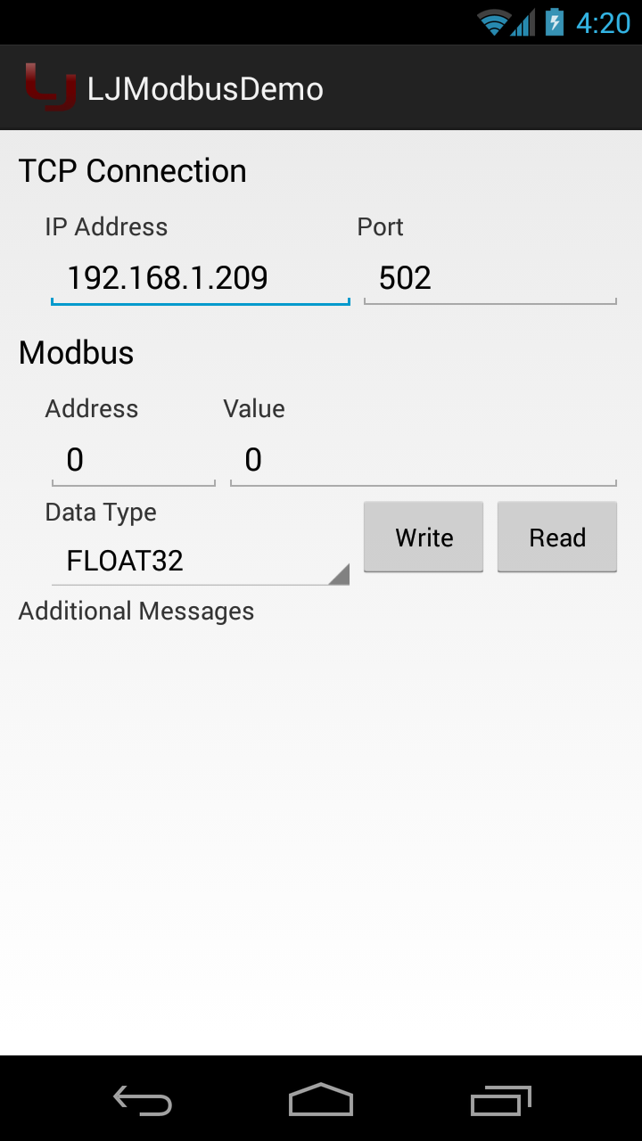
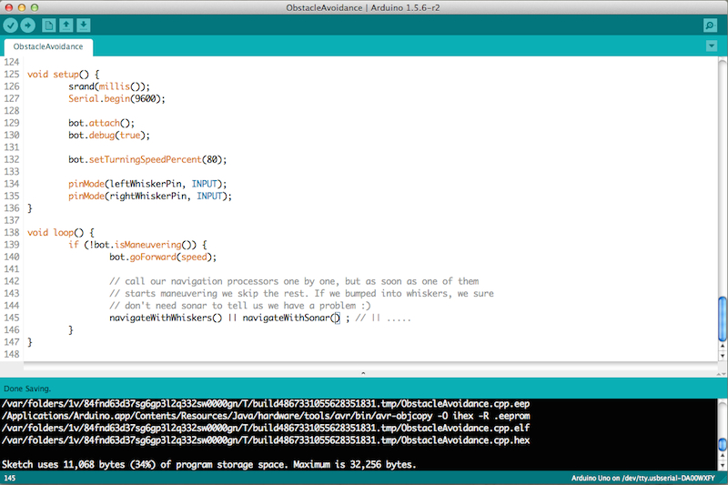
SOFTWARE IMPLEMENTATION
Arduino Compiler TCP/IP APP

Slide 24
APPLICATIONS:
REMOTE MONITORING AND ASSISTANCE
MACHINE CONTROL AND PRODUCTION
PREVENTIVE MAINTENANCE
ENERGY EFFICIENCY
ENVIRONMENTAL MONITORING

Slide 25
ADVANTAGES
Higher production rates
Increased productivity
More efficient use of materials
Better product quality
Improved safety
Shorter workweeks for labors
Reduced factory lead times.

Slide 26
DISADVANTAGES
Unemployment: Unemployment rate increases due to machines replacing humans and putting those humans out of their jobs.
Technical Limitation: Current technology is unable to automate all the desired tasks.
Security Threats/Vulnerability: An automated system may have limited level of intelligence; hence it is most likely susceptible to commit error.
Unpredictable development costs: The research and development cost of automating a process may exceed the cost saved by the automation itself.
High initial cost: The automation of a new product or plant requires a huge initial investment in comparison with the unit cost of the product, although the cost of automation is spread in many product batches.

Slide 27
RESULTS:
RFID Sensor along with Motion Sensor
Input - We swipe an RFID card on the RFID reader.
Output - As soon as the sensor identifies the card number, the gate is opened and the person gets inside. After he gets inside, the motion sensor senses his/her presence and automatically closes the gate. We get an alert in the mobile application of the card number as who entered the premises.
Result Incurred - Workers who have access in the factory has their card numbers stored in the database. Outsiders cannot enter easily without authorization of the card or until their card number is stored in the database. Hence this system can be used as a safety system.

Slide 28
Fire Sensor
Input - We use a lighter near the fire sensor as the input.
Output - As soon as the sensor identifies the fire, immediately the buzzer alerts, the fan and the water pumps starts operating in order to extinguish the fire and the gate opens so that the workers can leave the factory premises. We get an alert in the mobile application as “fire alert”.
Result Incurred – This system can be used as an Automatic Fire Alert System.

Slide 29
Gas Sensor
Input - We use smoke emanating from the incense stick near the gas sensor as the input.
Output - As soon as the sensor identifies the smoke, immediately the buzzer alerts, and the fan starts operating in order to extinguish the smoke getting around and the gate opens so that the workers can leave the factory premises. We get an alert in the mobile application as “smoke detected”.
Result Incurred - This system can be used as Automatic Smoke Alert System.

Slide 30
Temperature Sensor
Input - We use the heat emanating from the incense stick near the temperature sensor as the input.
Output - As soon as the sensor identifies high temperature, the buzzer alerts and the fan starts operating in order to cool down the surrounding temperature. We get an alert in the mobile application as “temperature alert”.
Result Incurred - This system is mostly used in high temperature areas like boilers and power plants where the temperature is usually high. It is also used in normal temperature areas so that any changes in the temperature will alert the person present in the premises and they may avoid burns or other mishaps.

Slide 31
Light Sensor
Input - We cover the light sensor with our hands so that no light falls on the light sensor.
Output - As soon as the sensor identifies the dark surroundings, the LED present in the module lights up.
Result Incurred - This system is used in factories where lights are forever required.

Slide 32
CONCULSION
By implementing these system we can access the live data and also control the device interfaced with our system.
It helps for monitoring industrial appliances and to inform the responsible person to take appropriate measures.
To serve as an efficient backbone for achieving a network of sensors and actuators which can help for improving the performance of the day to day activities of the industry.

Slide 33
REFERENCES
Geetesh Chaudhari, Sudarshan Jadhav, Sandeep Batule, Sandeep Helkar, “Industrial Automation using Sensing based Applications for Internet of Things”, IARJSET Vol. 3, Issue 3, March 2016.
Keyur K. Patel, Sunil Patel, “IOT Based Data Logger for Monitoring and Controlling Equipment Working Status and Environmental Conditions”, IJIRCCE Vol. 4, Issue 4, April 2016.
Li Da Zu” Internet of Things in industries: A Survey” IEEE transaction on Industrial on Industrial informatica, vol,no, November 2014
Sadeque Reza khan Professor Dr .M.S.Bhat “GUI based Industrial Monitoring and control system” IEEE paper,2014
Ayman Sleman and Reinhard Moeller “Integration of wireless sensor network services into other Home and Industrial networks””IEEE paper.
Rajeev Piyare and Sengo Ro Lee” Smart home control and monitoring system using smart phone”ICCA 2013 ASTL Vol.24,pp.83-86,2013 © SERSC 2013.

